Slide 1
SSZG 518: Database Design and Applications
Today’s Class
ER to Relational Model
Relational Model - Concepts

Slide 2
Representation of Relationship Set
--This is a little more complicated--
Unary/Binary Relationship set
Depends on the cardinality and participation of the relationship
Two possible approaches
N-ary (multiple) Relationship set
Primary Key Issue
Identifying Relationship
No relational model representation necessary

Slide 3
Representing Relationship Set Unary/Binary Relationship
For one-to-one relationship w/out total participation
Build a table with two columns, one column for each participating entity set’s primary key. Add successive columns, one for each descriptive attributes of the relationship set (if any).
For one-to-one relationship with one entity set having total participation
Augment one extra column on the right side of the table of the entity set with total participation, put in there the primary key of the entity set without complete participation as per to the relationship.

Slide 4
Example – One-to-One Relationship Set
Degree
SID
Name
ID Code
Student
study
Major
Major
GPA
SID | Maj_ID Co | S_Degree
9999 | 07 | 1234
8888 | 05 | 5678
* Primary key can be either SID or Maj_ID_Co

Slide 5
Example – One-to-One Relationship Set
Condition
SID
Name
1:1 Relationship
S/N #
Student
Have
Laptop
Major
GPA
Brand
SID | Name | Major | GPA | LP_S/N | Hav_Cond
9999 | Bart | Economy | -4.0 | 123-456 | Own
8888 | Lisa | Physics | 4.0 | 567-890 | Loan
* Primary key can be either SID or LP_S/N

Slide 6
Representing Relationship Set Unary/Binary Relationship
For one-to-many relationship w/out total participation
Same thing as one-to-one
For one-to-many/many-to-one relationship with one entity set having total participation on “many” side
Augment one extra column on the right side of the table of the entity set on the “many” side, put in there the primary key of the entity set on the “one” side as per to the relationship.

Slide 7
Example – Many-to-One Relationship Set
Semester
SID
Name
N:1 Relationship
SSN
Student
Advisor
Professor
Major
GPA
Dept
Name
SID | Name | Major | GPA | Pro_SSN | Ad_Sem
9999 | Bart | Economy | -4.0 | 123-456 | Fall 2006
8888 | Lisa | Physics | 4.0 | 567-890 | Fall 2005
* Primary key of this table is SID

Slide 8
Representing Relationship Set Unary/Binary Relationship
For many-to-many relationship
Same thing as one-to-one relationship without total participation.
Primary key of this new schema is the union of the foreign keys of both entity sets.
No augmentation approach possible…

Slide 9
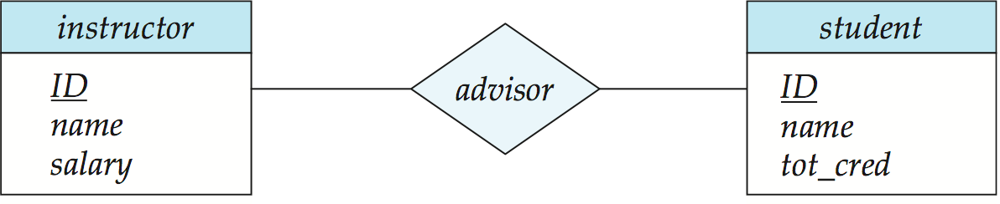
Representing Relationship Sets
A many-to-many relationship set is represented as a schema with attributes for the primary keys of the two participating entity sets, and any descriptive attributes of the relationship set.
Example: schema for relationship set advisor
advisor = (s_id, i_id)

Slide 10
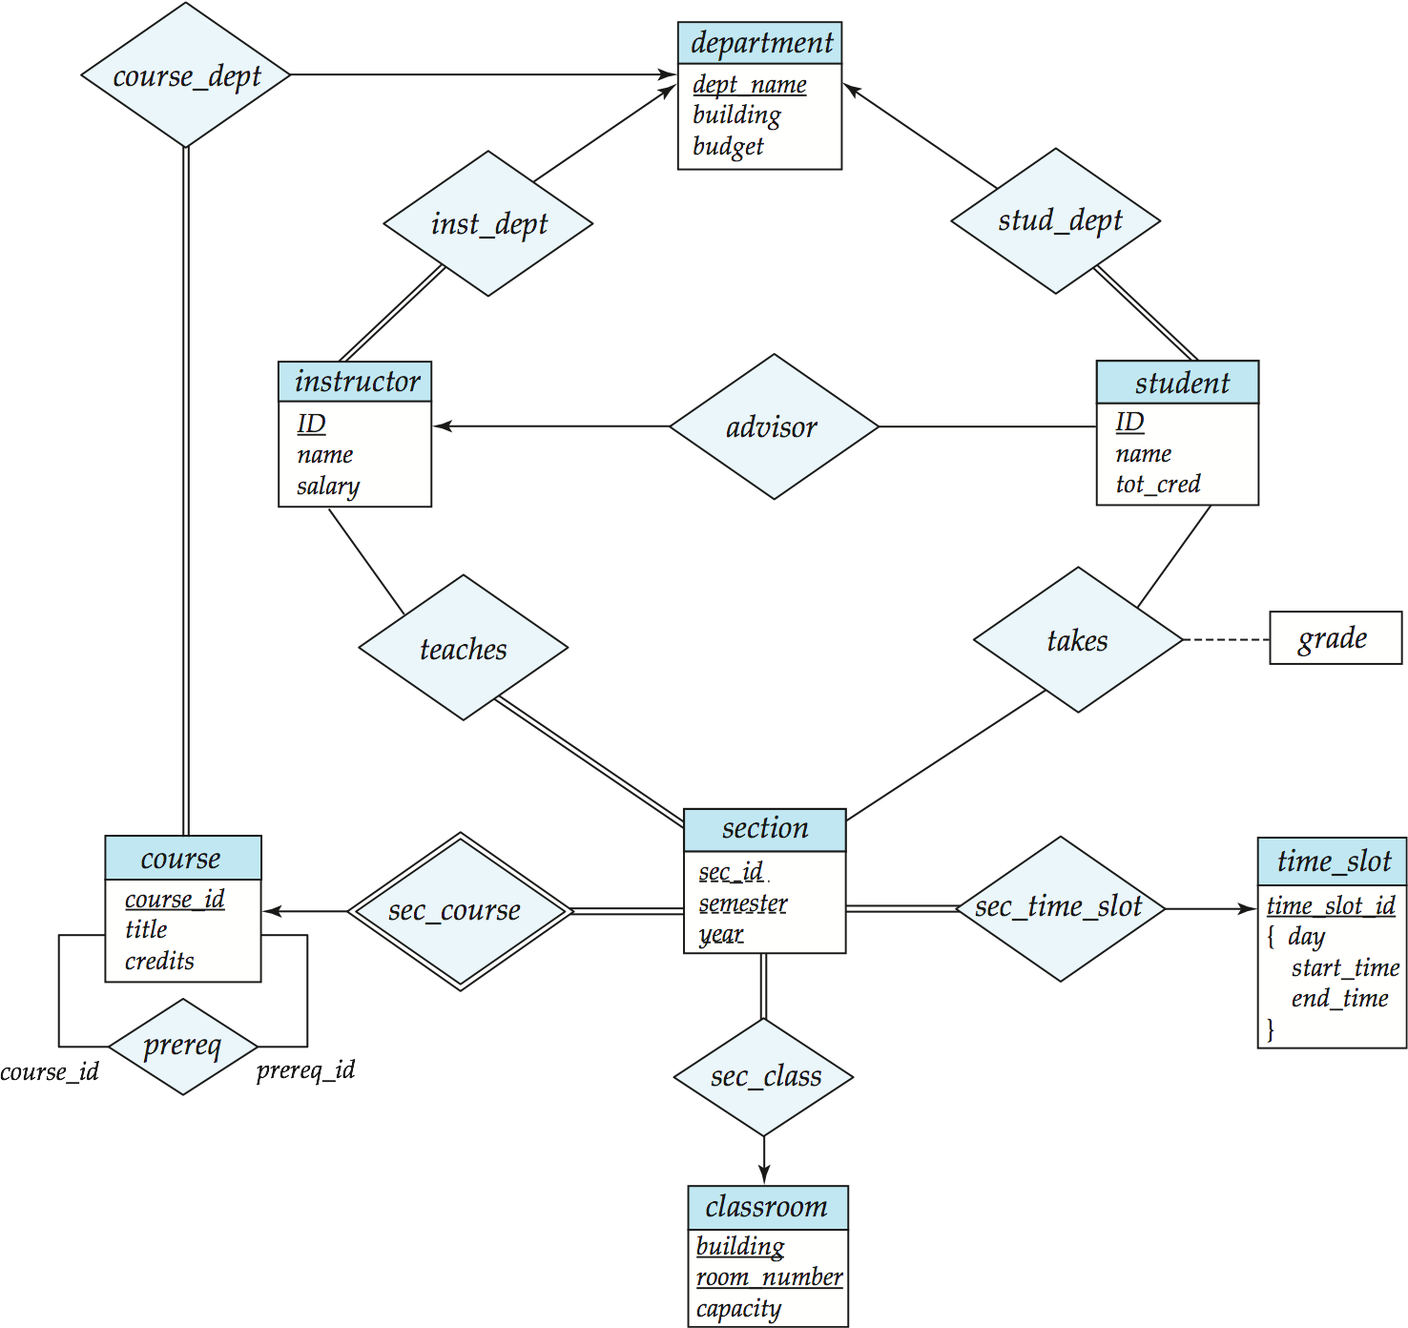
Redundancy of Schemas
Many-to-one and one-to-many relationship sets that are total on the many-side can be represented by adding an extra attribute to the “many” side, containing the primary key of the “one” side
Example: Instead of creating a schema for relationship set inst_dept, add an attribute dept_name to the schema arising from entity set instructor

Slide 11
Redundancy of Schemas
For one-to-one relationship sets, either side can be chosen to act as the “many” side
That is, extra attribute can be added to either of the tables corresponding to the two entity sets
If participation is partial on the “many” side, replacing a schema by an extra attribute in the schema corresponding to the “many” side could result in null values
The schema corresponding to a relationship set linking a weak entity set to its identifying strong entity set is redundant.
Example: The section schema already contains the attributes that would appear in the sec_course schema
Notes:
11

Slide 12
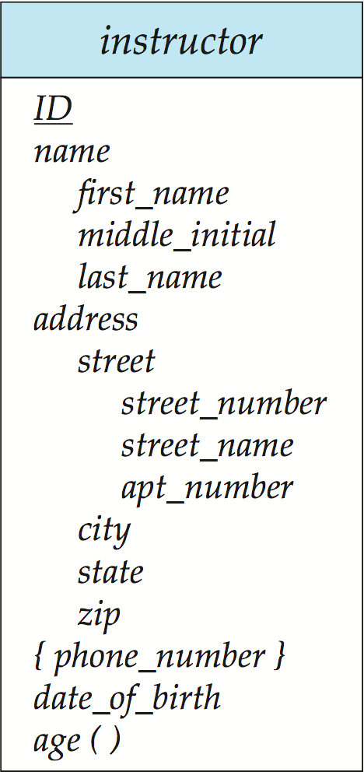
Composite and Multivalued Attributes
Composite attributes are flattened out by creating a separate attribute for each component attribute
Example: given entity set instructor with composite attribute name with component attributes first_name and last_name the schema corresponding to the entity set has two attributes name_first_name and name_last_name
Prefix omitted if there is no ambiguity
Ignoring multivalued attributes, extended instructor schema is
instructor(ID, first_name, middle_initial, last_name,street_number, street_name, apt_number, city, state, zip_code, date_of_birth)
Notes:
12

Slide 13
Composite and Multivalued Attributes
A multivalued attribute M of an entity E is represented by a separate schema EM
Schema EM has attributes corresponding to the primary key of E and an attribute corresponding to multivalued attribute M
Example: Multivalued attribute phone_number of instructor is represented by a schema: inst_phone= ( ID, phone_number)
Each value of the multivalued attribute maps to a separate tuple of the relation on schema EM
For example, an instructor entity with primary key 22222 and phone numbers 456-7890 and 123-4567 maps to two tuples: (22222, 456-7890) and (22222, 123-4567)
Notes:
13

Slide 14
Representing Composite Attribute
Relational Model Indivisibility Rule Applies
One column for each component attribute
NO column for the composite attribute itself
SSN
Name
SSN | Name | Street | City
9999 | Dr. Smith | 50 1st St. | Fake City
8888 | Dr. Lee | 1 B St. | San Jose
Professor
Address
Street
City

Slide 15
Representing Multivalue Attribute
For each multivalue attribute in an entity set/relationship set
Build a new relation schema with two columns
One column for the primary keys of the entity set/relationship set that has the multivalue attribute
Another column for the multivalue attributes. Each cell of this column holds only one value. So each value is represented as an unique tuple
Primary key for this schema is the union of all attributes

Slide 16
Example – Multivalue attribute
SID
Name
The primary key for this table is Student_SID + Children, the union of all attributes
Children
Student
Major
GPA
Stud_SID | Children
1234 | Johnson
1234 | Mary
5678 | Bart
5678 | Lisa
5678 | Maggie
SID | Name | Major | GPA
1234 | John | CS | 2.8
5678 | Homer | EE | 3.6

Slide 17
Multivalued Attributes (Cont.)
Special case:entity time_slot has only one attribute other than the primary-key attribute, and that attribute is multivalued
Optimization: Don’t create the relation corresponding to the entity, just create the one corresponding to the multivalued attribute
time_slot(time_slot_id, day, start_time, end_time)
Caveat: time_slot attribute of section (from sec_time_slot) cannot be a foreign key due to this optimization
Notes:
17

Slide 18
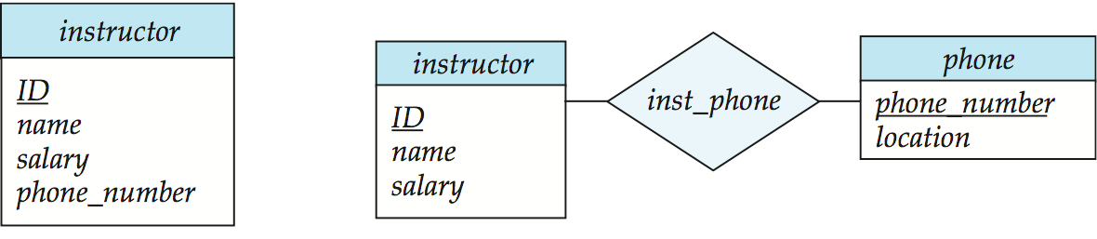
Design Issues
Use of entity sets vs. attributes
Use of phone as an entity allows extra information about phone numbers (plus multiple phone numbers)
Notes:
18

Slide 19
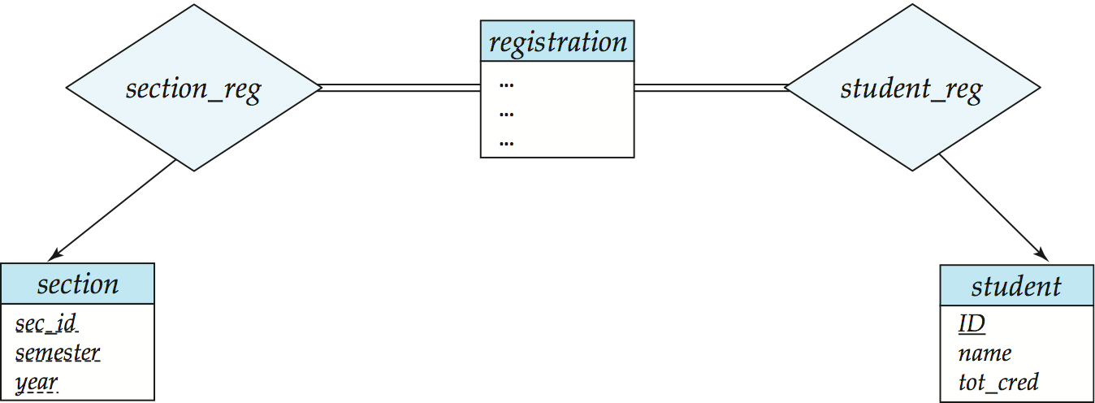
Design Issues
Use of entity sets vs. relationship sets Possible guideline is to designate a relationship set to describe an action that occurs between entities
Notes:
19

Slide 20
Design Issues
Binary versus n-ary relationship sets Although it is possible to replace any nonbinary (n-ary, for n > 2) relationship set by a number of distinct binary relationship sets, a n-ary relationship set shows more clearly that several entities participate in a single relationship.
Placement of relationship attributes
e.g., attribute date as attribute of advisor or as attribute of student
Notes:
20

Slide 21
Representing Relationship Set N-ary Relationship
Intuitively Simple
Build a new table with as many columns as there are attributes for the union of the primary keys of all participating entity sets.
Augment additional columns for descriptive attributes of the relationship set (if necessary)
The primary key of this table is the union of all primary keys of entity sets that are on “many” side
That is it, we are done.

Slide 22
Example – N-ary Relationship Set
P-Key1
D-Attribute
A-Key
E-Set 1
P-Key2
A relationship
Another Set
E-Set 2
P-Key3
E-Set 3
P-Key1 | P-Key2 | P-Key3 | A-Key | D-Attribute
9999 | 8888 | 7777 | 6666 | Yes
1234 | 5678 | 9012 | 3456 | No
* Primary key of this table is P-Key1 + P-Key2 + P-Key3

Slide 23
Review: ISA Hierarchies
If we declare A ISA B, every A entity is also considered to be a B entity.
name
ssn
lot
Employees
hourly_wages
hours_worked
ISA
contractid
Hourly_Emps
Contract_Emps
Overlap constraints: Can Joe be an Hourly_Emps as well as a Contract_Emps entity? (Allowed/disallowed)
Covering constraints: Does every Employees entity also have to be an Hourly_Emps or a Contract_Emps entity? (Yes/no)
Notes:
12

Slide 24
Translating ISA Hierarchies to Relations
General approach:
3 relations: Employees, Hourly_Emps and Contract_Emps.
Hourly_Emps: Every employee is recorded in Employees. For hourly emps, extra info recorded in Hourly_Emps (hourly_wages, hours_worked, ssn); must delete Hourly_Emps tuple if referenced Employees tuple is deleted).
Queries involving all employees easy, those involving just Hourly_Emps require a join to get some attributes.
Alternative: Just Hourly_Emps and Contract_Emps.
Hourly_Emps: ssn, name, lot, hourly_wages, hours_worked.
Each employee must be in one of these two subclasses.
Notes:
13

Slide 25
Representing Class Hierarchy
Two general approaches depending on disjointness and completeness
For non-disjoint and/or non-complete class hierarchy:
create a table for each super class entity set according to normal entity set translation method.
Create a table for each subclass entity set with a column for each of the attributes of that entity set plus one for each attributes of the primary key of the super class entity set
This primary key from super class entity set is also used as the primary key for this new table

Slide 26
Example
SSN
Name
Person
SID
Status
Gender
ISA
Student
Major
GPA
SSN | Name | Gender
1234 | Homer | Male
5678 | Marge | Female
SSN | SID | Status | Major | GPA
1234 | 9999 | Full | CS | 2.8
5678 | 8888 | Part | EE | 3.6

Slide 27
Representing Class Hierarchy
Two general approaches depending on disjointness and completeness
For disjoint AND complete mapping class hierarchy:
DO NOT create a table for the super class entity set
Create a table for each subclass entity set include all attributes of that subclass entity set and attributes of the superclass entity set
Simple and Intuitive enough, need example?

Slide 28
Example
SSN
Name
No table created for superclass entity set
SJSU people
ISA
SID
Student
Faculty
Disjoint and Complete mapping
Major
GPA
Dept
SSN | Name | SID | Major | GPA
1234 | John | 9999 | CS | 2.8
5678 | Mary | 8888 | EE | 3.6
SSN | Name | Dept
1234 | Homer | C.S.
5678 | Marge | Math

Slide 29
Representing Aggregation
Name
SSN
Name
Student
Advisor
Professor
Dept
SID
Name
member
Primary Key of Advisor
Dept
SID | Code
1234 | 04
5678 | 08
Code
Primary key of Dept

Slide 30
Relational Model Concepts
Relational Model of data is based on the concept of RELATION
A Relation is a Mathematical concept based on idea of SETS
The strength of the relational approach to data management comes from the formal foundation provided by the theory of relations

Slide 31
Relational Model Concepts
The model was first proposed by Dr. E.F. Codd of IBM in 1970 in the following paper: "A Relational Model for Large Shared Data Banks," Communications of the ACM, June 1970.
The above paper caused a major revolution in the field of Database management and earned Ted Codd the coveted ACM Turing Award in 1981

Slide 32
Some Terms
Table
Row or Record
Column or Field
No. of Rows
No. of Columns
Unique Identifier
Pool of Legal Values
Relation
Tuple
Attribute
Cardinality
Degree or Arity
Primary key
Domain

Slide 33
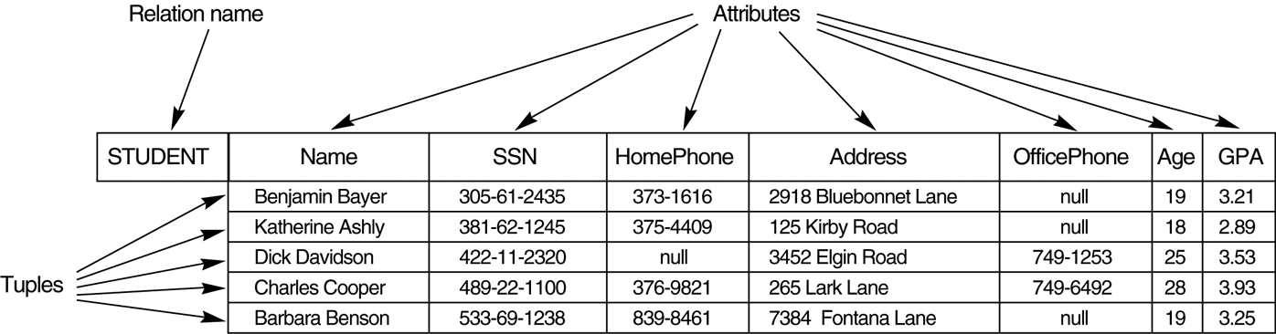
Example Relation
Cardinality = 5
Degree = 7
Primary Key is SSN

Slide 34
Domains & Data Types
Significance of domains
Domain-constrained comparisons
Select …..
From P, SP
Where P.P# = SP.P#
Select …..
From P, SP
Where P.weight = SP.qty
Both are valid queries in SQL, but second one makes no sense!!
Domains implemented as Data-Types?

Slide 35
Relational Systems
In relational systems, the DB is perceived by the user as relations & nothing else
Relations are only logical structures
At the physical level, the system is free to store the data in any way it likes – using sequential files, indexing, hashing…
Provided it can map stored representations to relations

Slide 36
Relational Systems
Consider the relations:
Dept(dept#, dname, budget)
D1 MKTNG 10M
D2 DEV 12M
D3 RES 5M
Emp(emp#, ename, dept#, salary)
E1 LOPEZ D1 40K
There is a connection between tuples E1 & D1. The connection is represented, not by a pointer, but by the occurrence of value D1 in E1.
In non-relational systems, such information is typically represented by some kind of pointer that is visible to the user.

Slide 37
Relational Systems
In relational systems, there are no pointers at the logical level
Pointers will be there at the physical level
Physical storage details are concealed from the user in relational systems

Slide 38
Relational Systems
Information Principle
The entire information content of the DB is represented in one & only one way, namely as explicit values in attribute positions in tuples in relations
NO POINTERS connecting one relation to another

Slide 39
Properties of Relations
There are no duplicate tuples
Body of a relation is a mathematical set
Tuples are unordered, top to bottom
Body of a relation is a mathematical set
No such thing as fifth tuple, next tuple ..
No concept of positional addressing
Attributes are unordered, left to right
Heading of a relation is a mathematical set
No concept of positional addressing
All attribute values are atomic
Normalized (1st Normal Form)

Slide 40
Types of Relations
Base Relations
The original (given) relations
Derived Relations
Relations obtained from base relations
Views
“Virtual” derived relation
Only definition is stored in the catalog
Definition executed at run-time
Snapshots
“Real” derived relation
Query Result
Unnamed derived relation

